Slide 1
Gradient Boosting Machine (GBM) and XGBoost

Slide 2
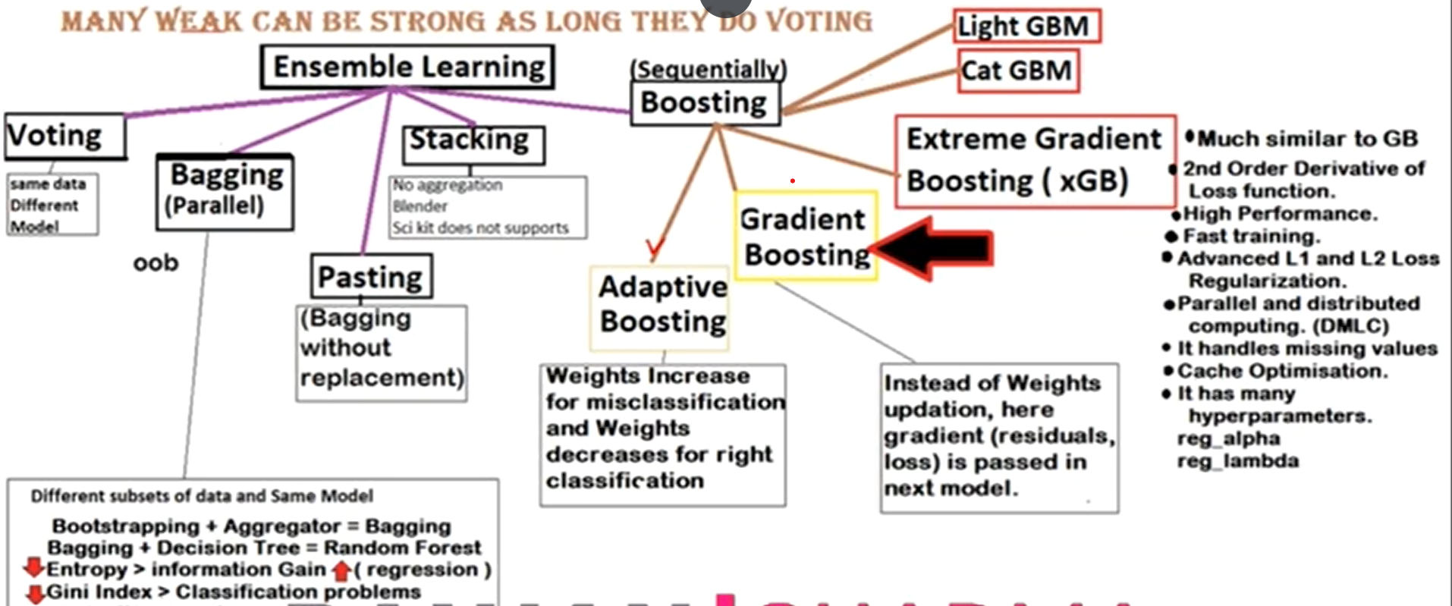
Ensemble Learning

Slide 3
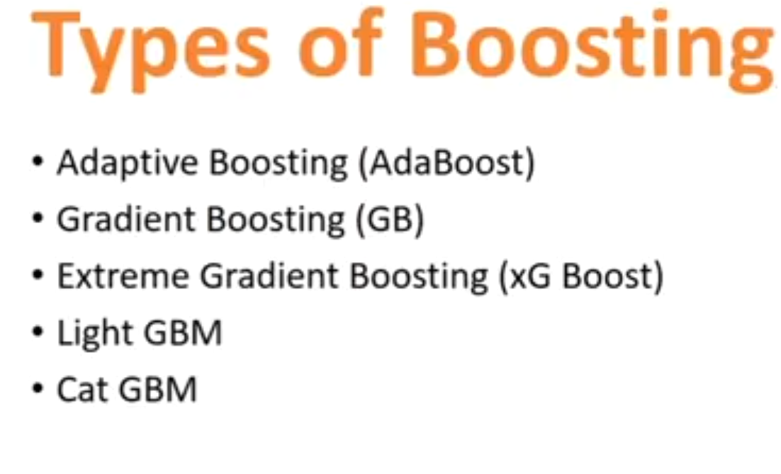

Slide 4
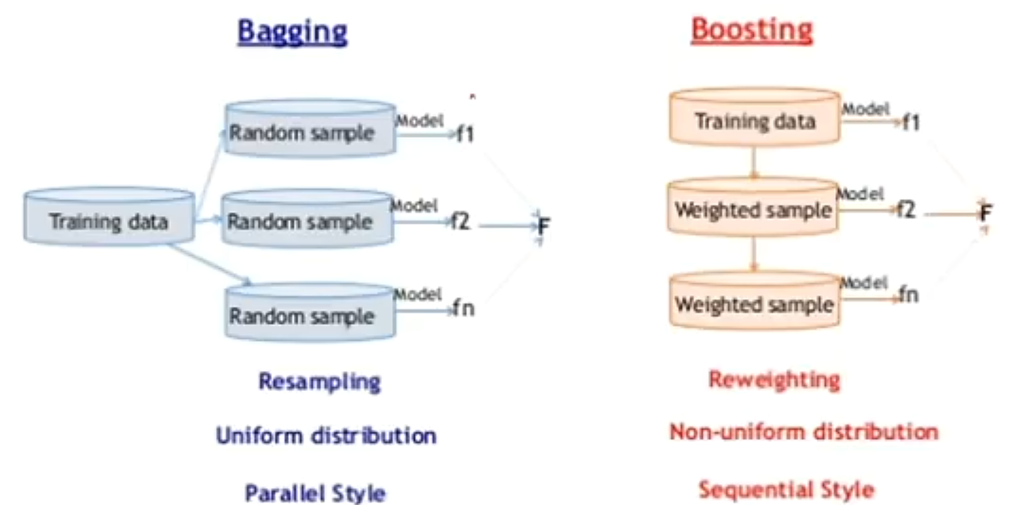











Slide 5
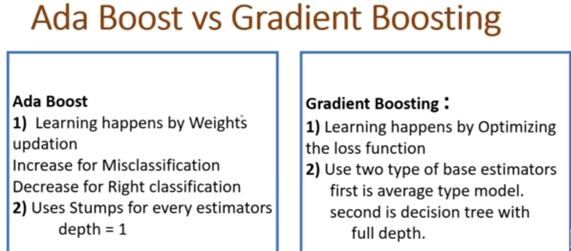

Slide 6
“Why bother with gradient boosting?”
There are a number of excellent reasons:
Gradient boosting is the best: its accuracy and performance are unmatched for tabular supervised learning tasks.
Gradient boosting is highly versatile: it can be used in many important tasks such as regression, classification, ranking, and survival analysis.
Gradient boosting is interpretable: unlike black-box algorithms like neural networks, gradient boosting does not sacrifice interpretability for performance. It works like a Swiss watch and yet, with patience, you can teach how it works to a school kid.
Gradient boosting is well-implemented: it is not one of those algorithms that have little practical value. Various gradient boosting libraries like XGBoost and LightGBM in Python are used by hundreds of thousands of people.
Gradient boosting wins: since 2015, professionals have used it to consistently win tabular competitions on platforms like Kaggle.

Slide 7
Real-World Applications of Gradient Boosting
Gradient boosting has become such a dominant force in machine learning that its applications now span various industries, from predicting customer churn to detecting asteroids. Here’s a glimpse into its success stories in Kaggle and real-world use cases:
Dominating Kaggle competitions:
Otto Group Product Classification Challenge: all top 10 positions used XGBoost implementation of gradient boosting.
Santander Customer Transaction Prediction: XGBoost-based solutions again secured the top spots for predicting customer behavior and financial transactions.
Netflix Movie Recommendation Challenge: Gradient boosting played a crucial role in building recommendation systems for multi-billion companies like Netflix.
Transforming business and industry:
Retail and e-commerce: personalized recommendations, inventory management, fraud detection
Finance and insurance: credit risk assessment, churn prediction, algorithmic trading
Healthcare and medicine: disease diagnosis, drug discovery, personalized medicine
Search and online advertising: search ranking, ad targeting, click-through rate prediction

Slide 8
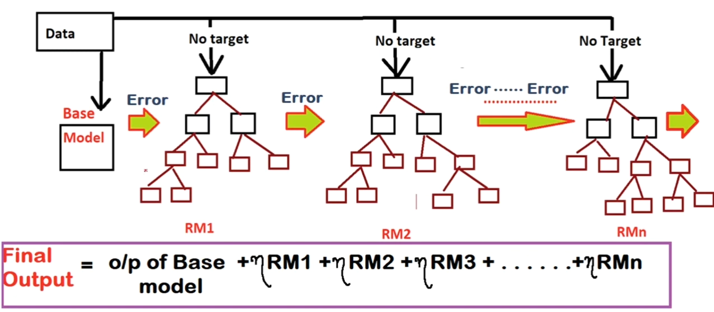
Gradient Boosting

Slide 9
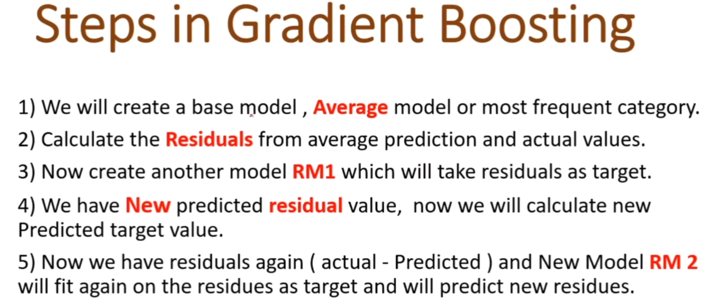

Slide 10
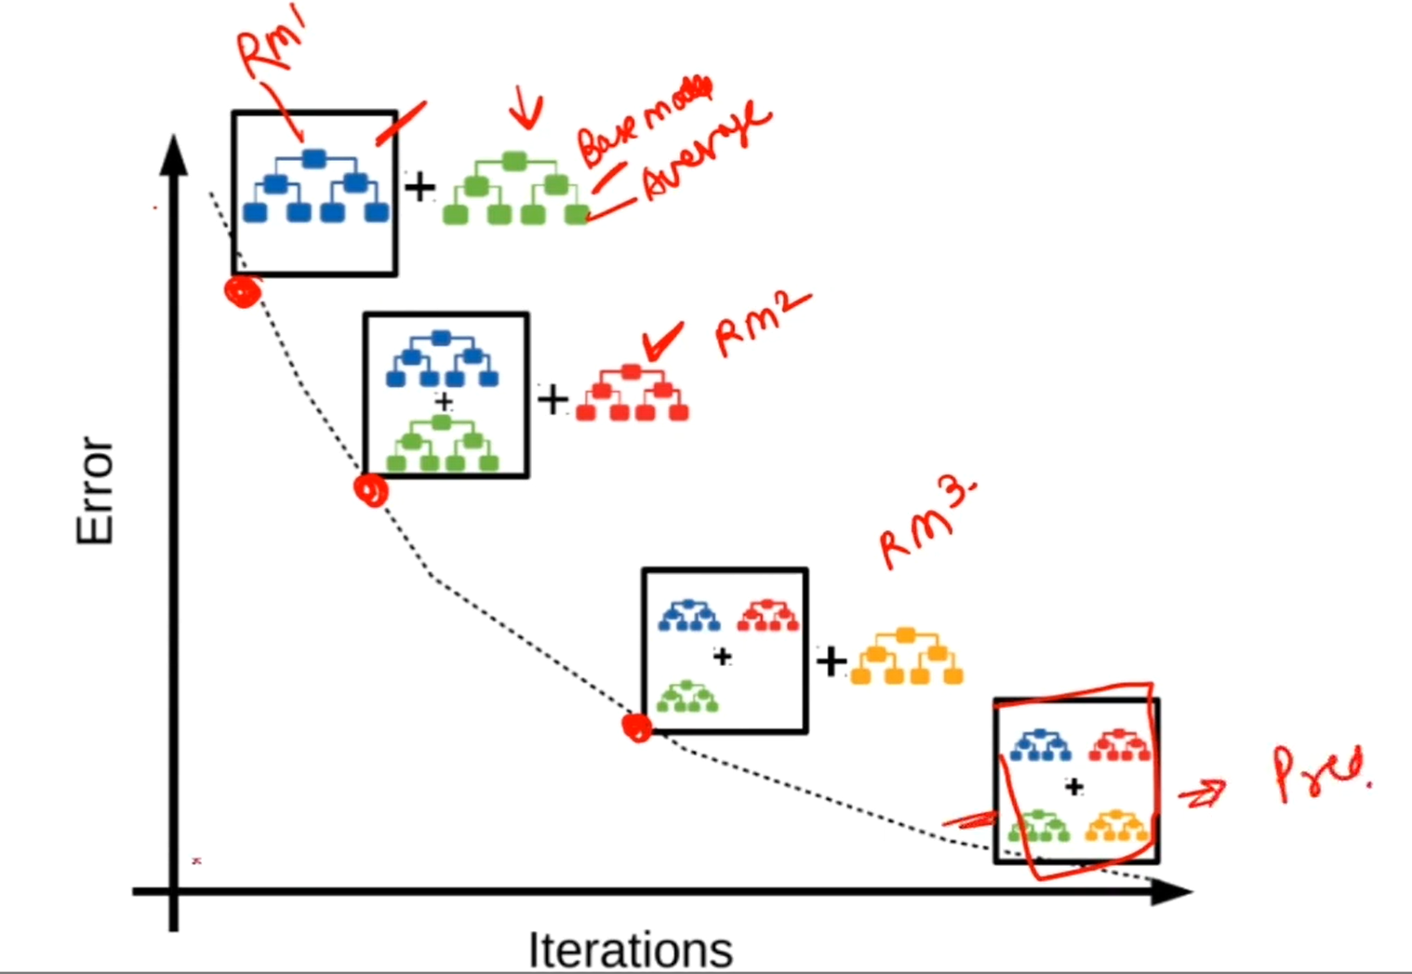
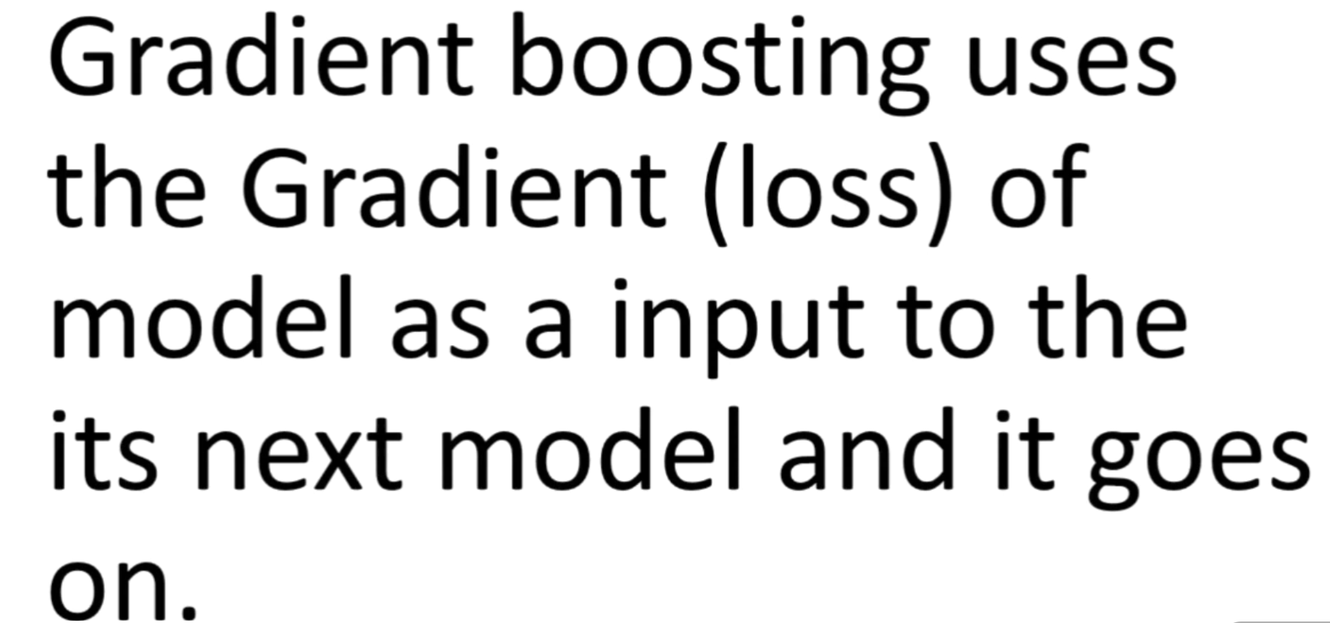

Slide 11
Step by step algorithm with example
Input
Gradient boosting algorithm works for tabular data with a set of features (X) and a target (y). Like other machine learning algorithms, the aim is to learn enough from the training data to generalize well to unseen data points.
To understand the underlying process of gradient boosting, we will use a simple sales dataset with four rows. Using three features — customer age, purchase category, and purchase weight, we want to predict the purchase amount:

Slide 12
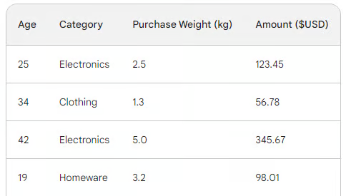




Example data

Slide 13
The loss function in gradient boosting
In machine learning, a loss function is a critical component that lets us quantify the difference between a model’s predictions and the actual values. In essence, it measures how a model is performing.
Here is a breakdown of its role:
Calculates the error: Takes the predicted output of the model and compares it to the ground truth (actual observed values). How it compares, i.e., calculates the difference, varies from function to function.
Guides model training: a model’s objective is to minimize the loss function. Throughout training, the model continually updates its internal architecture and configuration to make the loss as little as possible.
Evaluation metric: By comparing the loss on training, validation, and test datasets, you can assess your model’s ability to generalize and avoid overfitting.

Slide 14
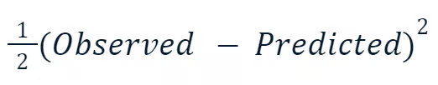







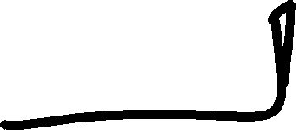






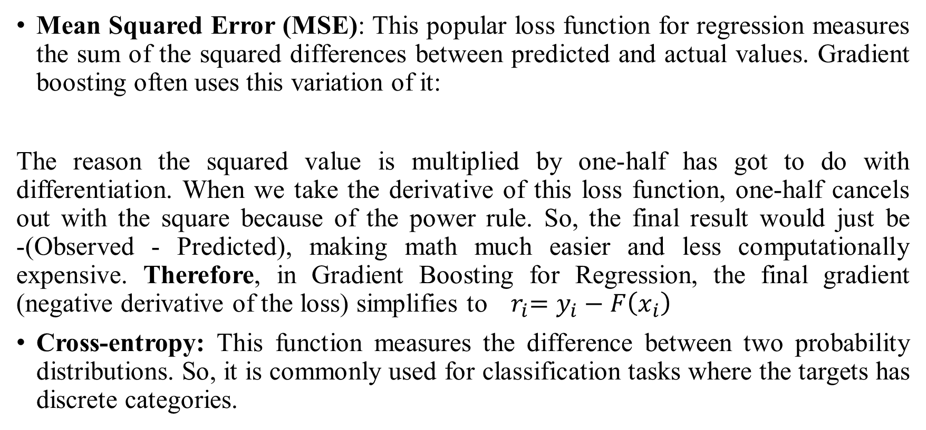
Two most common loss functions
Mean Squared Error (MSE): This popular loss function for regression measures the sum of the squared differences between predicted and actual values. Gradient boosting often uses this variation of it:
The reason the squared value is multiplied by one-half has got to do with differentiation. When we take the derivative of this loss function, one-half cancels out with the square because of the power rule. So, the final result would just be -(Observed - Predicted), making math much easier and less computationally expensive. Therefore, in Gradient Boosting for Regression, the final gradient (negative derivative of the loss) simplifies to ${ r}_{i}=y_{i}−F\left(x_{i}\right)$
Cross-entropy: This function measures the difference between two probability distributions. So, it is commonly used for classification tasks where the targets has discrete categories.

Slide 15

Step 1: Make an initial prediction
Gradient boosting is an algorithm that gradually increases its accuracy. To start the process, we need an initial guess or prediction. The initial guess is always the average of the target. In other words, for the first round, our model predicts that all purchases were the same — 156 dollars:
So, our initial prediction is the average — 156 dollars. Hold it in memory as we continue.

Slide 16
Step 2: Calculate the pseudo-residuals
The next step is to find the differences between each observed value and our initial prediction: Observed-156. Remember that in linear regression, the difference between observed values and predicted values is called residuals.
To differentiate linear regression and gradient boosting, we call them pseudo-residuals.
For illustration, we will put those differences in a new column:

Slide 17
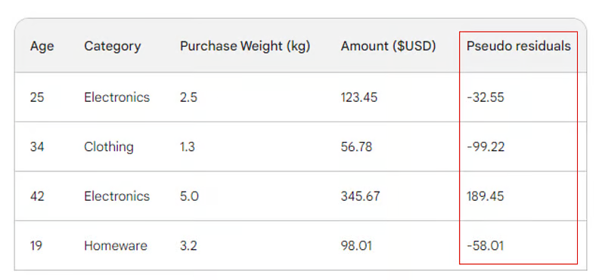





Step 2: Calculate the pseudo-residuals

Slide 18
Step 3: Build a weak learner
Next, we will build a decision tree (weak learner) that predicts the residuals using the three features we have (age, category, purchase weight). For this problem, we will limit the decision tree to just four leaves (terminal nodes), but in practice, people usually choose leaves between 8 and 32.

Slide 19
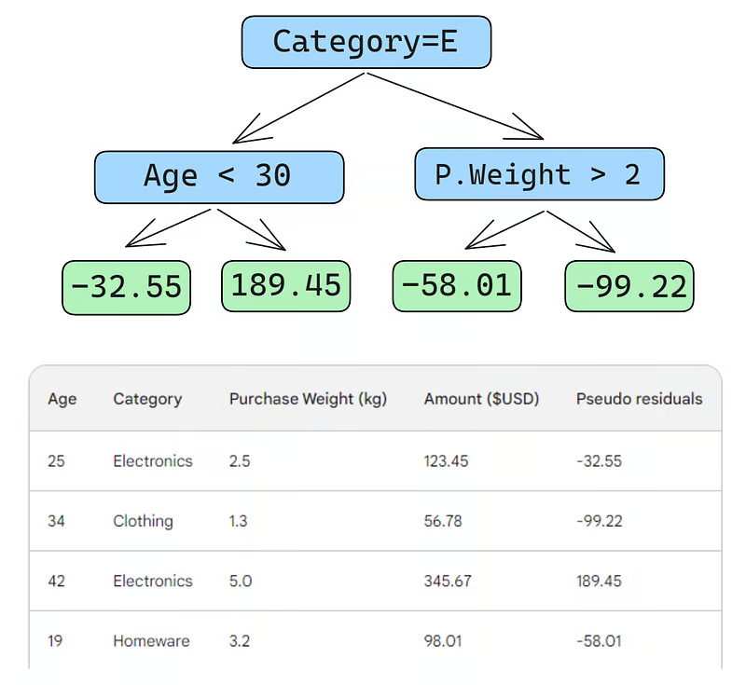












Slide 20
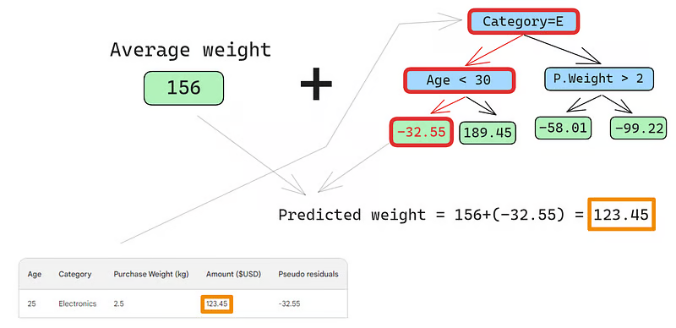
Making predictions
After the tree is fit to the data, we make a prediction for each row in the data. Here is how to do the first one: “Predicted purchase amount is denoted by “Predicted weight”

Slide 21
Role of learning parameter
The first row has the following features: a category of electronics (the left of the root node) and customer age below 30 (the left of the child node). This puts -32.55 into the leaf node. To make the final prediction, we add -32.55 to our first prediction, which is exactly the same as the observed value — 123.45 dollars!
We just made a perfect prediction, so why bother with building other trees? Well, right now, we are heavily overfitting to the training data. We want the model to generalize. So, to mitigate this problem, gradient boosting has a parameter called learning rate.
The learning rate in gradient boosting is simply a multiplier between 0 and 1 that scales the prediction of each weak learner (see the section below for details on learning rate). When we add an arbitrary learning rate of 0.1 into the mix, our prediction becomes 152.75, not the perfect 123.45.

Slide 22
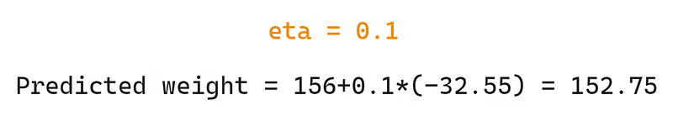
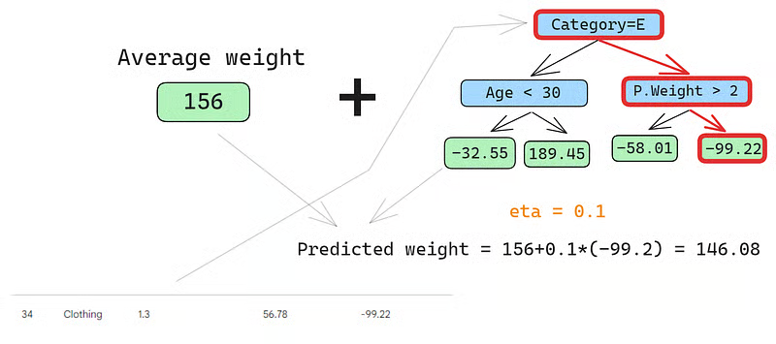









Let’s predict on the second row as well:

Slide 23
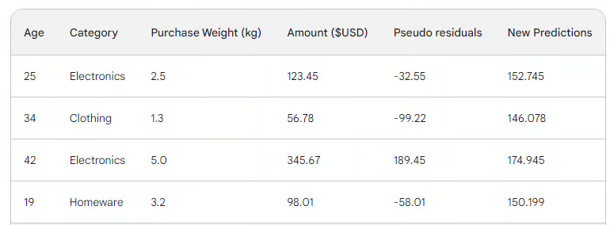




















Iterating over the other rows
We run the row through the tree and get 146.08 as a prediction. We continue in this fashion for all rows until we have four predictions for four rows: 152.75, 146.08, 174.945, 150.2. Let’s add them as a new column for now:

Slide 24
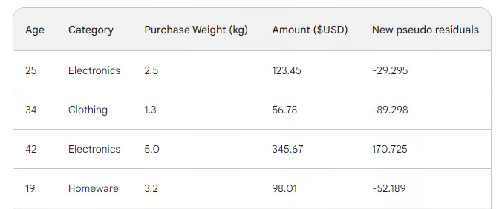















Calculating new residuals
Next, we find the new pseudo-residuals by subtracting new predictions from the purchase amount. Let’s add them as a new column to the table and drop the last two:
As you can see, our new pseudo residuals are smaller, which means our loss is going down.

Slide 25
Step 4: Iterate
In the next steps, we iterate on step 3, i.e. build more weak learners. The only thing to remember is that we have to keep adding the residuals of each tree to the initial prediction to generate the next.
For example, if we build 10 trees and the residuals of each tree are denoted as r_i (1 <= i <= 10), the next prediction would become p_10 = 156 + eta * (r_1 + r_2 + ... + r_10) where p_10 denotes prediction in the tenth round.
In practice, professionals often start with 100 trees, not just 10. In this case, the algorithm is said to train for 100 boosting rounds.

Slide 26
Early Stopping
If you don’t know the exact number of trees you need for your specific problem, you can use a simple technique called early stopping.
In early stopping, we choose a large number of trees, like 1000 or 10000. Then, instead of waiting for the algorithm to finish building all those trees, we monitor the loss. If the loss doesn’t improve for a certain number of boosting rounds, for example, 50, we stop training earlier, saving time and computation resources.

Slide 27
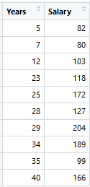
Another Example
Consider the following data where the years of experience is predictor variable and salary (in thousand dollars) is the target. Using regression trees as base learners, we can create an ensemble model to predict the salary. For the sake of simplicity, we can choose square loss as our loss function and our objective would be to minimize the square error. Assume Learning rate=1.

Slide 28
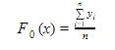
Steps
F0(x) gives the predictions from the first stage of our model. Now, the residual error for each instance is (yi – F0(x)).

Slide 29
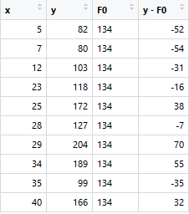



Steps

Slide 30
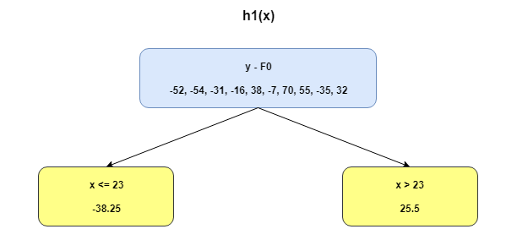









Building Additive Learners
We can use the residuals from F0(x) to create h1(x). h1(x) will be a regression tree which will try and reduce the residuals from the previous step. The output of h1(x) won’t be a prediction of y; instead, it will help in predicting the successive function F1(x) which will bring down the residuals.

Slide 31
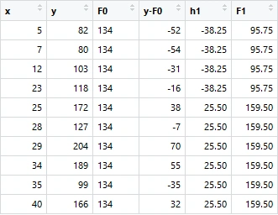













Steps
The additive model h1(x) computes the mean of the residuals (y – F0) at each leaf of the tree. The boosted function F1(x) is obtained by summing F0(x) and h1(x). This way h1(x) learns from the residuals of F0(x) and suppresses it in F1(x).

Slide 32
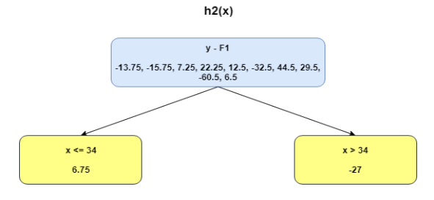




Steps
This can be repeated for 2 more iterations to compute h2(x) and h3(x).

Slide 33
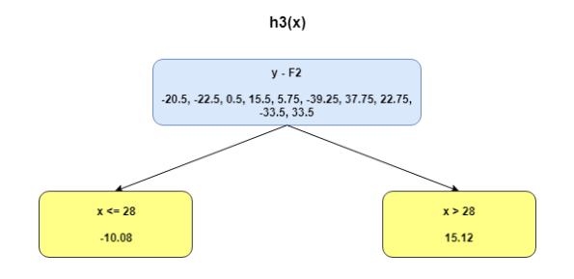
Steps

Slide 34
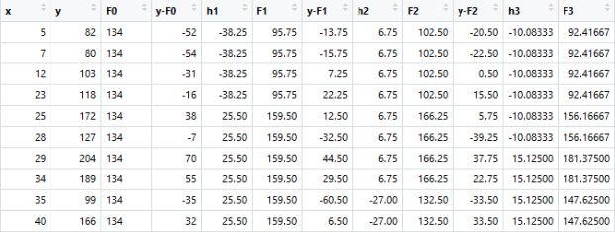









Steps
The MSEs for F1(x), F1(x) and F2(x) are 875, 692 and 540. It’s amazing how these simple weak learners can bring about a huge reduction in error!

Slide 35
Configuring Gradient Boosting Models
In machine learning, choosing the settings for a model is known as "hyperparameter tuning." These settings, called "hyperparameters," are options that the machine learning engineer must choose themselves. Unlike other parameters, the model cannot learn the best values for hyperparameters simply by being trained on data.
Gradient boosting models have many hyperparameters, some of which I will outline below.
Objective
This parameter sets the direction and the loss function of the algorithm. If the objective is regression, MSE is chosen as a loss function, whereas for classification, Cross-Entropy is the one to go. Python libraries like XGBoost offer other objectives for other types of tasks, such as ranking with corresponding loss functions.

Slide 36
Configuring Gradient Boosting Models
Learning rate: The most important hyperparameter of gradient boosting is perhaps the learning rate. It controls the contribution of each weak learner by adjusting the shrinkage factor. Smaller values (towards 0) decreases how much say each weak learner has in the ensemble. This requires building more trees and, thus, more time to finish training. But, the final strong learner will indeed be strong and impervious to overfitting.
The number of trees: This parameter, also called the number of boosting rounds or n_es timators, controls the number of trees to build. The more trees you build, the stronger and more performant the ensemble becomes. It also becomes more complex as more trees allows the model to capture more patterns in the data. However, more trees significantly improve the chances of overfitting. To mitigate this, employ a combination of early stopping and low learning rate.
Max depth: This parameter controls the number of levels in each weak learner (decision tree). A max depth of 3 means there are three levels in the tree, counting the leaf level. The deeper the tree, the more complex and computationally expensive the model becomes. Choose a value close to 3 to prevent overfitting. Your maximum should be a depth of 10.

Slide 37
Configuring Gradient Boosting Models
Minimum number of samples per leaf: This parameter controls how branches split in decision trees. Setting a low value for the number of samples in termination nodes (leaves) makes the overall algorithm sensitive to noise. A larger minimum number of samples helps to prevent overfitting by making it more difficult for the trees to create splits based on too few data points.
Subsampling rate: This parameter controls the proportion of the data used to train each tree. In the examples above, we used 100% of rows as there were only four rows in our dataset. But, real-world datasets often have much more and require sampling. So, if you set the subsampling rate to a value below 1, such as 0.7, each weak learner trains on the randomly sampled 70% of the rows. A smaller subsample rate can lead to faster training but can also lead to overfitting.
Feature sampling rate: This parameter is exactly like subsampling, but it samples rows. For datasets with hundreds of features, it is recommended to choose a feature sampling rate between 0.5 and 1 to lower the chance of overfitting.

Slide 38
Difference between Adaboost and Gradient Boosting
Features | AdaBoost | Gradient Boosting
Weight Update Strategy | Increase weights of misclassified sample so that the next learner focuses more on them. | Updates predictions by minimizing a loss function using the negative gradient
Base learners | AdaBoost uses simple decision trees with one split known as the decision stumps of weak learners. | Gradient Boosting can use a wide range of base learners such as decision trees and linear models.
Sensitivity to Noise | AdaBoost is more sensitive to noisy data and outliers due to aggressive weighting. | Gradient Boosting is less sensitive as it smooths updates using gradients.
Optimization Technique | No explicit loss function i.e it focuses on classification error. | Explicitly minimizes a differentiable loss function.
Boosting Mechanism | Learners are trained sequentially with sample reweighting. | Learners are trained sequentially with residual fitting (gradient descent).
Interpretability | Easier to interpret due to simple weak learners. | Harder to interpret if complex models are used.
Use case | Suitable for clean datasets with fewer outliers | Suitable for complex problems with varying loss function

Slide 39
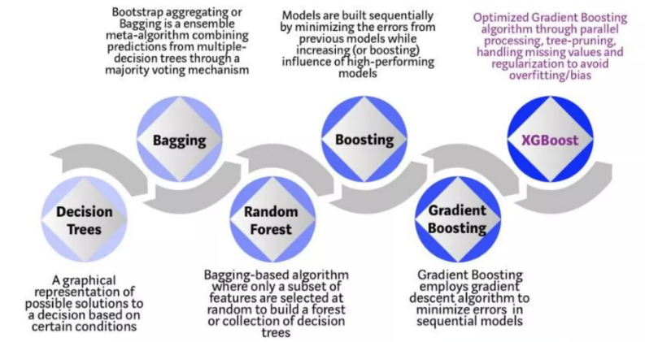
Evolution of tree-based algorithms

Slide 40
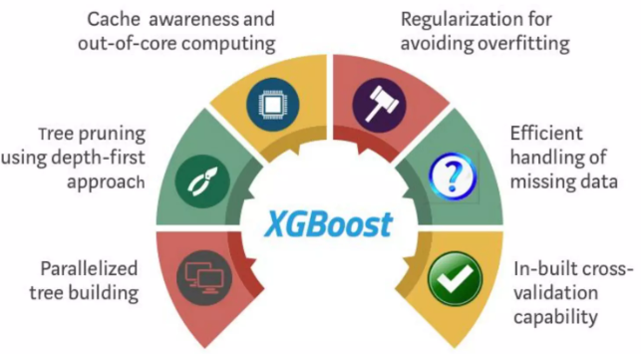
Unique features of XGBoost

Slide 41
Unique Features of XGBoost Model
XGBoost model is a popular implementation of gradient boosting. There are some features or metrics of XGBoost that make it so interesting:
Regularization: XGBoost has an option to penalize complex models through both L1 and L2 regularization. Regularization helps in preventing overfitting
Handling sparse data: Missing values or data processing steps like one-hot encoding make data sparse. XGBoost Classifier incorporates a sparsity-aware split finding algorithm to handle different types of sparsity patterns in the data
Weighted quantile sketch: Most existing tree-based algorithms can find the split points when the data points are of equal weights (using quantile sketch algorithm). However, they are not equipped to handle weighted data. XGBoost has a distributed weighted quantile sketch algorithm to effectively handle weighted data.

Slide 42
Unique Features of XGBoost Model
Block structure for parallel learning: For faster computing, XGBoost Classifier can make use of multiple cores on the CPU. This is possible because of a block structure in its system design. Data is sort and store data in in-memory units called blocks. Unlike other algorithms, this approach enables subsequent iterations to reuse the data layout instead of computing it again. This feature also serves useful for steps like split finding and column sub-sampling.
Cache awareness: In XGBoost machine learning, Scala requires non-continuous memory access to obtain the gradient statistics by row index. Hence, Tianqi Chen designed XGBoost to optimize hardware usage. This optimization occurs by allocating internal buffers in each thread, where the workflow can store the gradient statistics. And these parallel tree make better XGboost algorithms with the help of julia and java lanuages.
Out-of-core computing: This feature optimizes the available disk space and maximizes its usage when handling huge datasets that do not fit into memory

Slide 43
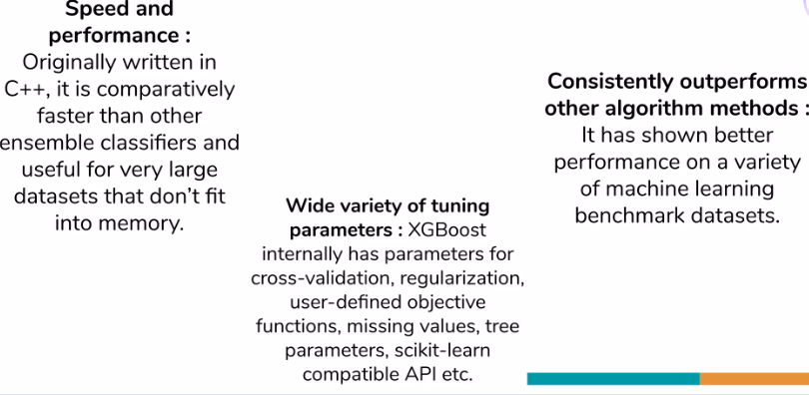
Why XGBoost?

